Slide 1
CS 4530: Fundamentals of Software Engineering Lesson 5.3 Testing Systems
Jonathan Bell, Adeel Bhutta, Ferdinand Vesely, Mitch Wand
Khoury College of Computer Sciences
© 2022 Released under the CC BY-SA license

Slide 2
Learning Objectives for this Lesson
By the end of this lesson, you should be able to:
Explain why you might need a "test double“ in your testing
Explain the differences between different kinds of test “doubles” such as “stubs, mocks, spies, fakes”

Slide 3
Review: What is the purpose of Test Suite?
Test Driven Development
Does the SUT satisfy its specification? (“functional testing”)
Regression Test
Did something change since some previous version?
Prevent bugs from (re-)entering during maintenance.
Acceptance Test
Does the SUT satisfy the customer (requirement testing)
Validation: Are we building the right system ?
These purposes are copied from Lesson 5.2

Slide 4
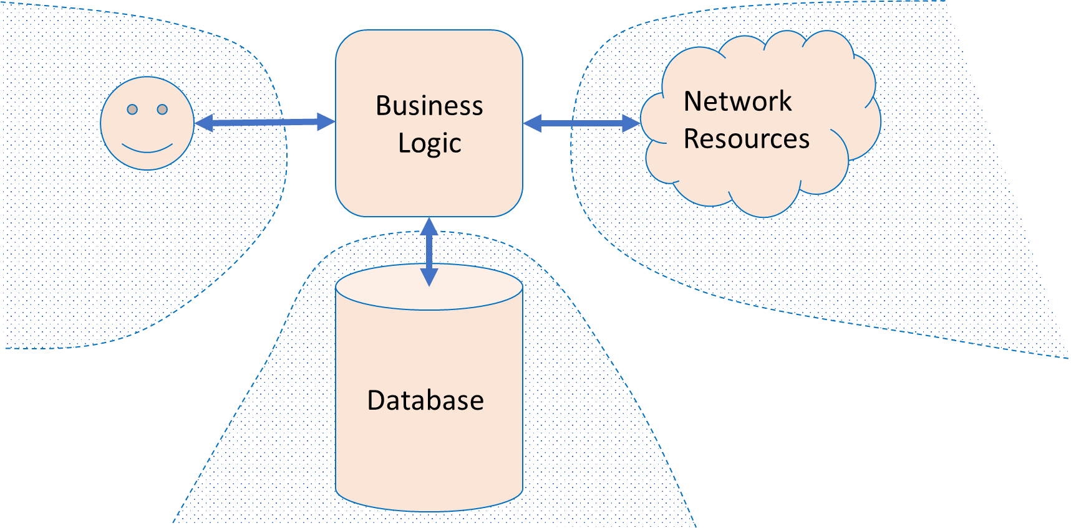
Large Systems are Hard to Test
Database component
Contents may need to reflect/simulate real-world;
Data may be expensive/proprietary/confidential.
Network connections
”Real” connections may be slow/flaky/disrupted;
Resources may have changed since test was written.
Environment
Interactions with OS, locale or other software.
Human actors
Ultimately unpredictable.
4
Notes:
<read slide>

Slide 5
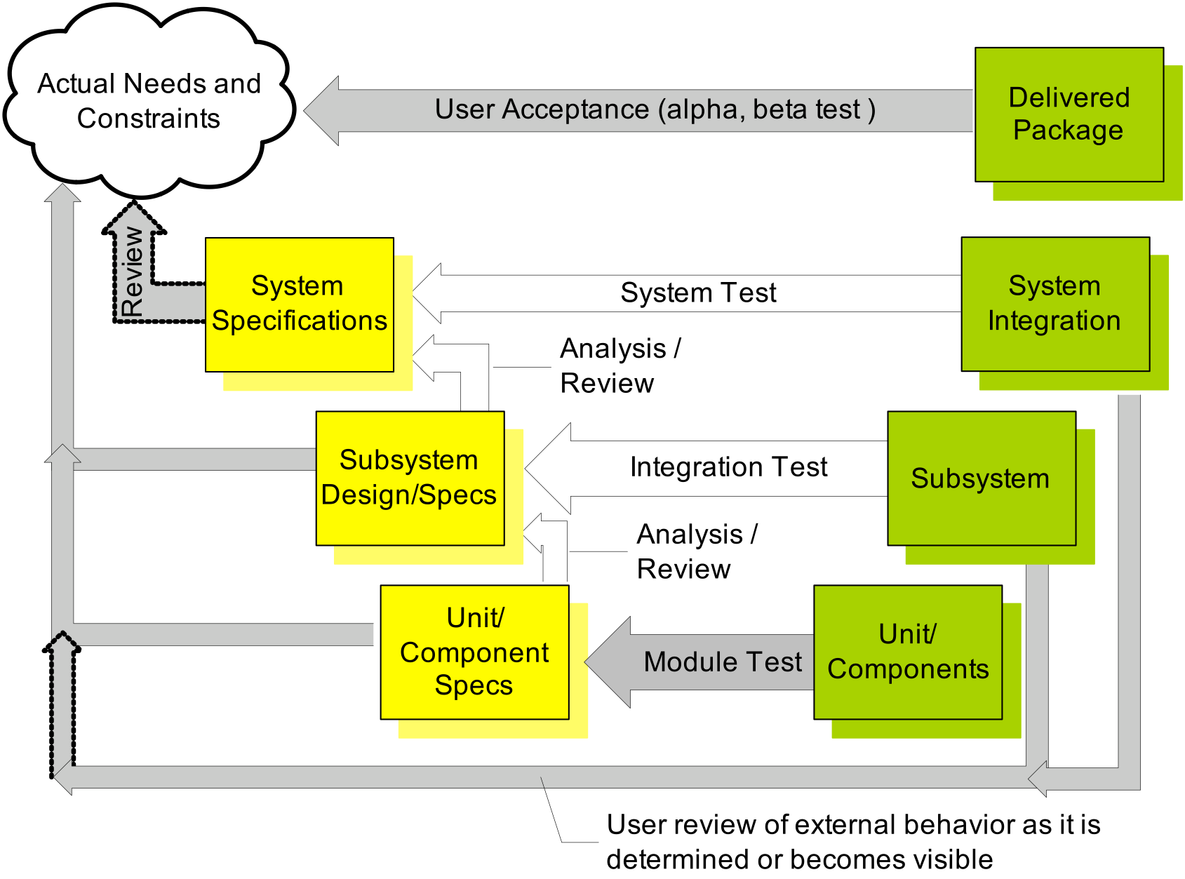
Unit Testing is not sufficient
You are used to using Drivers and Stubs in your tests
Overall systems are “a little more” complicated
Driver
Stub
Stub
5
Notes:
You are probably familiar with use of drivers and stubs from your earlier programming courses. They are often used for simple programs

Slide 6
Test Doubles replace uncontrollable pieces of the environment
Mo
Business Logic
Network
Resources
Random user
Database
Mock network
Fake Database
Notes:
Real systems are hardly that simple. You are often working with a software with a lot of pieces. A typical system may be accessing a dB and some online web services, and can have a bunch of users.
Instead of interacting with real network or read web service, we can use “doubles”. This is a term similar to the one used in movies.

Slide 7
What are Test Doubles?
Mo
Business Logic
Network
Resources
Test Double
Test Double
Test Double
Random user
Database
Mock network
Fake Database
Notes:
Doubles are things that look like the real thing but they are not real.
If you are working on a system which sends an email to customer after an operation, how will you test it? Instead of sending a real email every time you test, you can use doubles (i.e., a mock mail service)
One way to say this is: you need test doubles when you code (or function) has side effects.

Slide 8
We will talk about four kinds of doubles:
Stubs, which just supply the same interface as the original
Spies, which remember how the object was called
Mocks, which respond to messages with scripted results
Jest has good built-in support for creating mocks, spies, and stubs
Fakes, which is a mock with “semi-real” implementation
Our transcript server was an example of a fake

Slide 9
A Test Stub is a Double that just supplies the same interface
Supply an object with the same interface:
Same methods;
Default result values (i.e., canned answers).
The stub gets the test to run:
If the client blindly uses the stub, it can proceed;
If the client expects something specific from the object, the test will likely fail.
Notes:
Stubs provide canned answers to calls made during the test, usually not responding at all to anything outside what's programmed in for the test.

Slide 10
Test Stub Example
final class Service {
public function doSomething(UserModelInterface user): Int {
/* Do things */
return user.uuid;
}
}
final class ServiceTest extends TestCase {
public function testDoSomething(): void {
// The service needs a implementation `UserModelInterface`.
String uuid = (new Service()).doSomething(new UserStub());
self.assertStringContainsString('0000-000-000-00001', uuid);
}
}
interface UserModelInterface {
public function getUuid(): String;
}
final class UserStub implements UserModelInterface {
public function getUuid(): String {
return '0000-000-000-00001';
}
}
getUuid() is a stub
Notes:
A stub is an object which returns fake data. Let’s imagine our service depends on a user-model, then the service does something, and finally, it returns the user’s UUID. We can create a stub object with fake values to assert the service works as expected. This is Java code, something you may have seen in OOD.

Slide 11
Sometimes a Stub is not enough
You might want your stub to do atleast two more things:
Remember how the stub was used; (“memory”)
Program the responses of the stub for different situations.
Notes:
Use Stubs to:
provide a predetermined response from a collaborator
take a predetermined action from a collaborator, like throwing an exception
Use Mocks to:
verify the contract between the code under test and a collaborator
verify the the collaborator's method is called the correct number of times
verify the collaborator's method is called with the correct parameters

Slide 12
Test Spy is a stub that remembers how the object was called
Test can check what happened earlier;
For example: a particular method should be called
First with parameters “foo” and 42;
Then with parameters “quux” and -88.
A spy can be useful in conjunction with the “real” environment:
What was sent on the network?
How many times a problem was logged?
What was inserted in the database?
But most often used with a “mock.” (we will discuss this later)
Spy “remembers”
Notes:
Spies are stubs that also record some information based on how they were called. One form of this might be an email service that records how many messages it was sent. This is an example of spy being used with a real email service

Slide 13
Test Spy Example
final class UserNotifierTest extends TestCase {
public function testLogMessage(): void {
LoggerSpy logger = new LoggerSpy();
UserNotifier notifier = new UserNotifier(logger);
User user = new User(name = 'Jesus');
notifier.registerUser(user);
self.assertStringContainsString(
"Notifying the user: {user.name()}",
first(logger.messages) ); }}
interface Logger {
public function log(String message): void;
}
final class LoggerSpy implements Logger {
public Array messages = [];
public function log(string message): void {
this.messages[] = message;
}
}
final class UserNotifier {
public function __construct(private Logger logger) {}
public function registerUser(UserModelInterface user): void {
this.logger.log("Notifying the user: {user.name()}");
// ...
}
}
Logger “remembers” messages
Notes:
A test spy is an object capable of capturing indirect output and providing indirect input as needed. The indirect output is something we cannot directly observe. In the snippet, we can know exactly how many times the log() method has been called, as well as the content of the messages. The point of this spy is to have much more knowledge of the internal object state in exchange for deeper coupling, which could be problematic in the future because it makes our tests more fragile.

Slide 14
Test Mock is a Double that has Scripted results
A test mock has scripted results:
If such-and-such a method is called
return some particular value.
A complex mock can have many scripts:
Multiple methods;
Different results for subsequent calls.
Useful mocking assumes we know how mocked object will be used.
If a “mock” has real logic, it becomes a “fake” (we will discuss this later).
Mock has “scripted answers” and is used for “behavior verification”
Notes:
Mocks are objects pre-programmed with expectations which form a specification of the calls they are expected to receive. It is used to record and verify the interaction between classes/components. A mock is known as the most powerful and flexible version of the test doubles.
The mock objects are generally used for behavior verification. The term behavior means to check the correct methods and paths that are applied to the objects.
Mocks are mostly created by using a library or a mocking framework like Mockito, JMock, and EasyMock. It is used for testing a large suite of tests where stubs are not sufficient.

Slide 15
Jest supports Mocks
Jest’s Mock API: https://jestjs.io/docs/mock-function-api
Replacing TwilioVideo with Mock
You will see more of these in HW3
const mockTwilioVideo = mockDeep<TwilioVideo>();
jest.spyOn(TwilioVideo, 'getInstance').mockReturnValue(mockTwilioVideo);
Jest Tests can be written
it('should use the coveyTownID and player ID properties when requesting a video token',
async () => {
const townName = `FriendlyNameTest-${nanoid()}`;
const townController = new CoveyTownController(townName, false);
const newPlayerSession = await townController.addPlayer(new Player(nanoid()));
expect(mockTwilioVideo.getTokenForTown).toBeCalledTimes(1);
expect(mockTwilioVideo.getTokenForTown).toBeCalledWith(townController.coveyTownID, newPlayerSession.player.id);
});
Notes:
There are three main types of module and function mocking in Jest: jest.fn: Mock a function
jest.mock: Mock a module
jest.spyOn: Spy or mock a function Here is a nice review:
https://medium.com/@rickhanlonii/understanding-jest-mocks-f0046c68e53c

Slide 16
Here is another Example of Mock /1
describe('conversationAreaCreateHandler', () => {
const mockCoveyTownStore = mock<CoveyTownsStore>();
const mockCoveyTownController = mock<CoveyTownController>();
beforeAll(() => {
// Set up a spy for CoveyTownsStore that will always return our mockCoveyTownsStore as the singleton instance
jest.spyOn(CoveyTownsStore, 'getInstance').mockReturnValue(mockCoveyTownStore);
});
beforeEach(() => {
// Reset all mock calls, and ensure that getControllerForTown will always return the same mock controller
mockReset(mockCoveyTownController);
mockReset(mockCoveyTownStore);
mockCoveyTownStore.getControllerForTown.mockReturnValue(mockCoveyTownController);
});
. . . .
spying on getInstance() method
Notes:
This test will spy on the getInstance method of CoveyTownsStore, always returning a mock instance. Then, whenever getControllerForTown is called, it will always return a mock CoveyTownController.

Slide 17
Here is another Example of Mock /2
. . . .
it('Checks for a valid session token before creating a conversation area', ()=>{
const coveyTownID = nanoid();
const conversationArea :ServerConversationArea = { boundingBox: { height: 1, width: 1, x:1, y:1 }, label: nanoid(), occupantsByID: [], topic: nanoid() };
const invalidSessionToken = nanoid();
// Make sure to return 'undefined' regardless of what session token is passed
mockCoveyTownController.getSessionByToken.mockReturnValueOnce(undefined);
requestHandlers.conversationAreaCreateHandler({
conversationArea,
coveyTownID,
sessionToken: invalidSessionToken,
});
expect(mockCoveyTownController.getSessionByToken).toBeCalledWith(invalidSessionToken);
expect(mockCoveyTownController.addConversationArea).not.toHaveBeenCalled();
});
});
If SessionToken is invalid, don’t call addConversationArea()
Notes:
The test checks to see that conversationAreaCreateHandler does NOT call addConversationArea if the session token is invalid, which it simulates by mocking a return value of undefined for getSessionByToken

Slide 18
Test Fake is a Mock with semi-real implementation
A fake has an implementation of the object being replaced
A low-fidelity fake implements things partially
Enough to work for the test.
A high-fidelity fake implements most aspects:
Usually all functional aspects;
Usually not as efficiently or as scalable.
The purpose of the fake is to avoid processes/network/cost:
So the test can be cheap and deterministic.
Transcript Server you used in Activity 4.1 was a Fake
Fake has
“semi-real implementation”
Notes:
Fake objects actually have working implementations, but usually take some shortcut which makes them not suitable for production (an in memory database is a good example).
A fake is a simpler implementation of real objects.
Fakes are used when we want to test an infrastructural class, in other words, fakes are for the classes which are beyond our application limit (repositories or queues, for example).
Transcript Service was a Fake which probably would not scale but worked.

Slide 19
How do you provide a Test Double for a User?
To replace a user, we can program a “Bot”
Randomly use mouse, press buttons;
Arbitrary text;
Fast or slow.
Smarter (“Fuzzing”)
Capture real actions;
Then make targeted mutations.
(This applies also to programs taking text input.)
Expected result can only be imprecise:
e.g., “not crash” or “not leak secrets”.
Notes:
<read slide>

Slide 20
Weaknesses of Test Doubles
The Mock/Fake may not behave correctly
The test may assume wrong behavior;
Particularly an issue if original object changes
Mocks have to be maintained as well!
Solution: Test the mock/fake against a higher fidelity fake, or against the real thing.
The SUT may use a different algorithm:
The Spies expect a particular usage of double;
The test is “brittle” because it depends on internal behavior of SUT;
Notes:
<read slide>

Slide 21
Review: Learning Objectives for this Lesson
You should now be able to:
Explain why you might need a "test double“ in your testing
Explain the differences between different kinds of test “doubles” such as “stubs, mocks, spies, fakes”
For Further Reading
Check out Martin Fowler’s article, “Mocks Aren’t Stubs” https://martinfowler.com/articles/mocksArentStubs.html
“xUnit Test Patterns: Refactoring Test Code” by Gerard Meszaros

